Slide 1


REGISTERING ON THE GRANT APPLICATION PORTAL AS A FIRST TIME APPLICANT

Slide 2
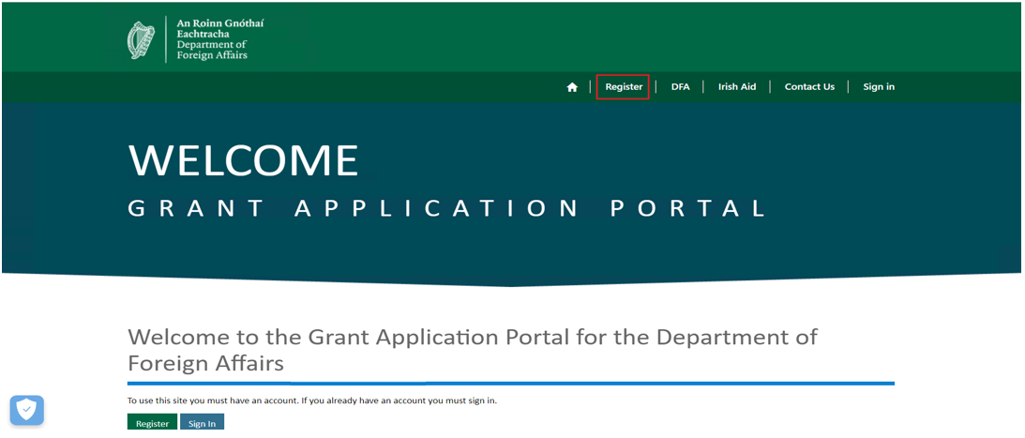
REGISTERING AS A FIRST TIME APPLICANT
PORTAL REGISTRATION
Members of the public can register through the portal by accessing the following link:
www.funding.dfa.ie
Click on “Register” to proceed with portal registration.

Slide 3
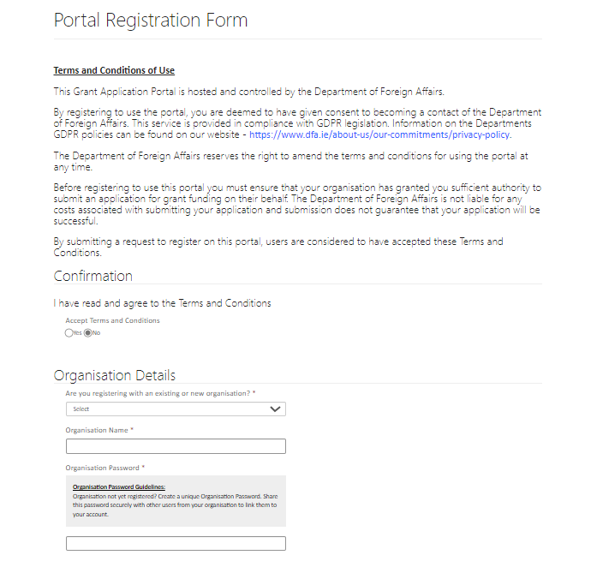
REGISTERING AS A FIRST TIME APPLICANT
PORTAL REGISTRATION FORM
1
1
Portal registration form will open
Click “Yes” to agree to Terms and Conditions
Fill in your Organisation Details
2
2
3
3

Slide 4
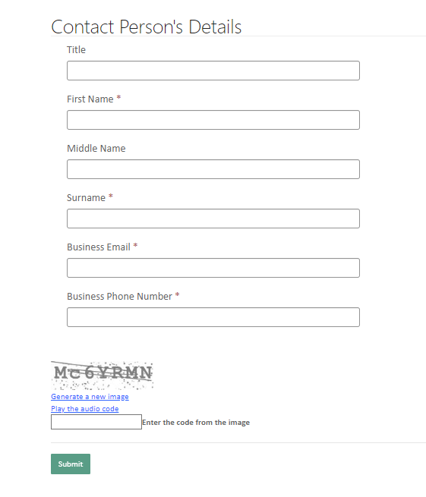
REGISTERING AS A FIRST TIME APPLICANT
PORTAL REGISTRATION FORM
4
4
Fill in your details, you will be the contact person for your organisation on this portal
5
Enter the code from the image and click “Submit”
5

Slide 5
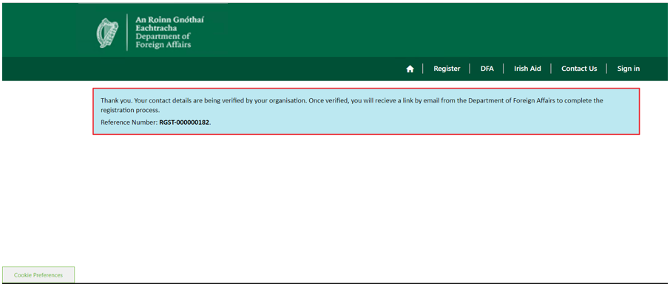
REGISTERING AS A FIRST TIME APPLICANT
PORTAL REGISTRATION FORM
A thank you message will confirm that the registration has been submitted. You will receive an email with a link to complete the registration process.

Slide 6
THANK YOU!

