Slide 1
We have NUMBERS in our DNA
Accounting
Technician
Apprenticeship

Slide 2
We have NUMBERS in our DNA
Accounting Technicians Ireland – ATI – is the leading professional Accounting Technicians body across the Island of Ireland.
Recognised as an Awarding Body by CCEA. Level 4 Certificate for Accounting Technicians; Level 5 Diploma for Accounting Technicians
ATI is a partner body with Chartered Accountants Ireland with extensive member network, and four active District Societies which provide access to an extensive community of practice
10,000-strong community with 5,500 full-qualified active Members; over 4,000 students registered annually
Strong links with professional accountancy bodies for exemptions purposes
About us

Slide 3
We have NUMBERS in our DNA
Accounting Technicians Ireland
Various routes to becoming a fully qualified Accounting Technician before going on to become an Accountant or continuing to higher education.
Four types of delivery
Full Time
Part Time
Online
Apprenticeship
10k Students and Members
(MIATI)
70 colleges in Ireland
16 colleges in Ireland
About us

Slide 4
ATA Colleges – 2018/19
Notes:
BIFE: Bray institute of further education – Wicklow; Kildare and Wicklow Education & Training Board
Coláiste íde: Westr Finglas Dublin West; City of Dublin Education & Training Board
BFEI: Blackrock College of Further Education – Dublin South; Dublin and Dún Laoghaire Education & Training Board
Rathmines College of Further Education – Dublin Central; City of Dublin Education & Training Board
Monaghan Institute – Monaghan; Cavan and Monaghan Education & Training Board
Cork College of Commerce – Cork; Cork Education & Training Board
Waterford College of Further Education; Wexford and Waterford Education & Training Board
Other regions will have come on board with college location in Jan 2019, Sept 2019 and so on

Slide 6
ATA: The practical route to
a Career in Accountancy
The Structure of the apprenticeship programme ensures that the training and education delivered is grounded in the needs of the workplace.
There are 8 Modules Covered On and Off-the-Job (across 2 years)
Apprentices are supported by a workplace-mentor* and a college mentor during their apprenticeship
*ATI Members who are workplace-mentors can claim CPD Hours
Modules
● Financial Accounting ● Taxation ● Law & Ethics ● Business Mgt. | ● Advanced Financial Accounting ● Advanced Taxation ● Management Accounting ● Integrated Accounting Systems
The ATA
Notes:
ATA - Accounting Technician Apprenticeship
The ATA offers a route to a career in accountancy
Apprentices attend college one day a week and are with their employer in work 4 days a week for 30 weeks.
The remainder of the year they have a 5 day working week, holidays, study and exam leave all in accordance with the employer HR T&C’s and those relating to the study and exam elements of the apprenticeship
Apprentices earn €9.55 per hour which is over €18k per anum.
Apprentices have a work place mentor and a college mentor

Slide 7
Advanced Certificate in Accounting (Level 6 award on the NFQ)
On-the-job and Off-the-job
Training
Stage 2
ATA
Fully Qualified Accounting Technician (MIATI)
Stage 1
ATA
On-the-job and Off-the-job Training
Work in industry or practice
Professional Accounting and
Higher Education Pathways
School-leaver, or
Mature student (over 23 years)
Applicant Type
Career Progression
ATA Career Pathway
Notes:
Stage 1
Modules Financial Accounting
Taxation
Business Management
Law & Ethics
Stage 2
Modules Advanced Financial Accounting
Advanced Taxation
Business Management
IAS – Integrated Accounting Systems
For Industry refer to public, private and third sector

Slide 9
Conall O'Halloran (President) Chartered Accountants Ireland

Slide 10
For Leaving Certificate Students 2017 - 2019
310 CAO Points
05 grade in English
05 grade in Maths or Accountancy
For Leaving Certificate Students 2016 or before
300 CAO Points
D3 Ordinary Level English
D3 Ordinary Level Maths or Accountancy
*Other criteria apply for Mature and PLC route applicants
Eligibility Requirements*
Notes:
See our website for full eligibility requirements

Slide 11
What do apprentices study?
Delivery Pattern – Four subjects per year for two years.
Year 1 Year 2
Taxation 1. Advanced Taxation
Financial Accounting 2. Advanced Financial Accounting
Law & Ethics 3. Management Accounting
Business Management 4. Integrated Accounting Systems
Study Leave Entitlement – Minimum 3 weeks including exam dates.
Two intakes per year: September & January
Workplace assessments are submitted twice a year, 8 work based tasks in total.
Exams take place in May and August of each year (repeats in August & October)
You’ll be supported by a mentor in your workplace and college as you undertake your apprenticeship
ATA Programme Overview

Slide 12
The on-the-job training lasts for the duration of 2 years (104 weeks) based on a 2 year employment contract and takes place with the employer 4 days a week in term time and 5 days a week outside term time. It is overseen by the workplace mentor.
The Role of the Workplace Mentor
To ensure apprentice has adequate exposure to all relevant work experience
To agree dates for periodic review meetings to review the apprentices
progress and modify the Learning Plan where necessary.
To meet with the employee on a weekly basis informally and to meet with
them formally every 10 – 12 weeks at a minimum.
To assess the apprentice’s work place assessment tasks and to ensure they are submitted
in line with the programme timetable.
On the Job Training
Notes:
Stage 1
Modules Financial Accounting
Taxation
Business Management
Law & Ethics
Stage 2
Modules Advanced Financial Accounting
Advanced Taxation
Business Management
IAS – Integrated Accounting Systems
For Industry refer to public, private and third sector

Slide 13
To advise ATI of any work place absences or other behaviour of the apprentice that might be a matter of concern
To advise ATI of any circumstances where the employer is considering invoking disciplinary procedures before commencing these procedures. ATI must be informed at first instance.
Must attend Training sessions with ATI
ATI will engage with Work place mentors to participate in the Accounting Technician Programme Board and Consortium. The Programme Board is responsible for the general oversight of delivery of the programme. The Consortium is responsible for the strategic direction of the programme.
The role of the workplace mentor (cont.)
Notes:
Stage 1
Modules Financial Accounting
Taxation
Business Management
Law & Ethics
Stage 2
Modules Advanced Financial Accounting
Advanced Taxation
Business Management
IAS – Integrated Accounting Systems
For Industry refer to public, private and third sector

Slide 14
Off-the-Job training is delivered in college and a College mentor provides support. The duration of off-the-job training Stages for the Accounting Technician are as follows:
Stage 1 – 240 hours in College (delivery over one academic year). 60 Hours per Module x 4 Modules
Stage 2 – 240 hours in College (delivery over one academic year). 60 Hours per Module x 4 Modules
Teaching Schemes for each module are provided to employers prior to the beginning of the academic year
Off the Job Training
Notes:
Stage 1
Modules Financial Accounting
Taxation
Business Management
Law & Ethics
Stage 2
Modules Advanced Financial Accounting
Advanced Taxation
Business Management
IAS – Integrated Accounting Systems
For Industry refer to public, private and third sector

Slide 15
The Primary role is to ensure the apprentice full integration into the social and support systems, as well as academic systems as soon as possible
The College mentor ensures that the apprentice stays on track with learning and with the programme through regular review meetings with the apprentices and the work place mentors.
The College Mentor acts as a bridge between the on and off the job delivery of the programme and visits the employer a minimum of twice a year.
They bring concerns swiftly to ATI’s Apprenticeship Programme Manager.
The role of the college mentor
Notes:
Stage 1
Modules Financial Accounting
Taxation
Business Management
Law & Ethics
Stage 2
Modules Advanced Financial Accounting
Advanced Taxation
Business Management
IAS – Integrated Accounting Systems
For Industry refer to public, private and third sector

Slide 16
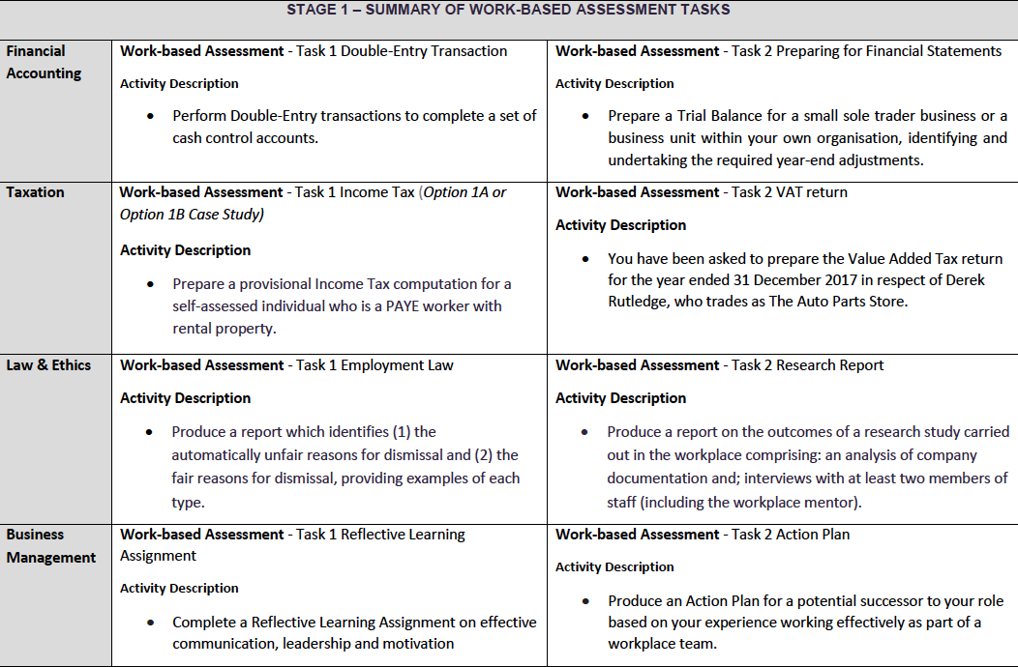
Work Based Tasks
Notes:
Stage 1
Modules Financial Accounting
Taxation
Business Management
Law & Ethics
Stage 2
Modules Advanced Financial Accounting
Advanced Taxation
Business Management
IAS – Integrated Accounting Systems
For Industry refer to public, private and third sector

Slide 17
Assessment of apprentices’ progress is carried out by a combination of two strategies:
• Examination (Terminal; 1 per module)
• Work-based Tasks (2 per Module).
The apprenticeship process is deemed to be complete when an apprentice has successfully achieved the required qualifying standard, completed all of the alternating on-the-job and off-the- job elements of their apprenticeship and served the appropriate minimum timeframe from the date of registration.
On successful completion of their apprenticeship, each apprentice will be awarded a QQI Level 6 Advanced Certificate and full membership of ATI
Assessment
Notes:
Stage 1
Modules Financial Accounting
Taxation
Business Management
Law & Ethics
Stage 2
Modules Advanced Financial Accounting
Advanced Taxation
Business Management
IAS – Integrated Accounting Systems
For Industry refer to public, private and third sector

Slide 18
Accounting Technician Apprenticeship
Recruitment Process
Complete the Suitability to Train form and provide
mentor credentials
MOU is signed & returned to ATI. GDPR signed. Forward to Solas for approval
3. Eligible Applicants are processed via ATI Telephone Interview
4. ATI will send vetted applications to registered employers
5. Employer reviews the batch and selects applicant to interview
6. Employer makes offer, Applicant Accepts & Starts at Employers
discretion
 Apprentice work start date at any time before college start date
7. Academic programme commences January and September of each year

Slide 19
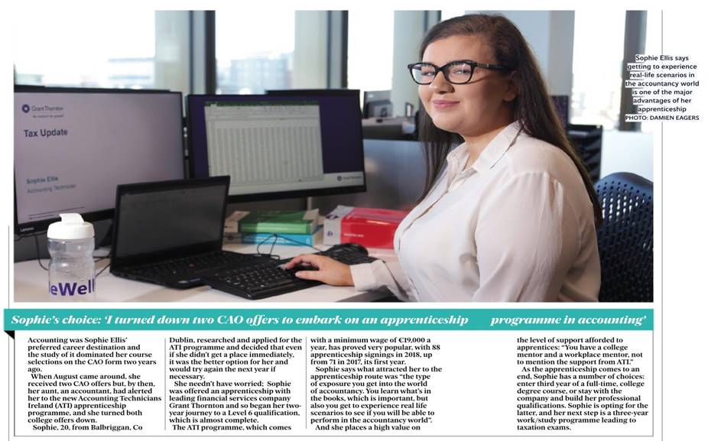

Slide 21
Gabriela Airini
Apprenticeship Director
gairini@accountingtechniciansireland.ie
Tel: (01) 649 8103
Aoife Kennedy
Programme Manager – Apprenticeship
akennedy@accountingtechniciansireland.ie
Tel: (01) 649 8126
Jonathan Seymour
Programme Manager – Higher Level Apprenticeship
JSeymour@accountingtechniciansireland.ie
Tel: 02820 462165
Daniel Phillips
Student Recruitment Executive
dphillips@accountingtechniciansireland.ie
Tel: (01) 649 8127
For further information please visit:
www.accountingtechniciansireland.ie; www.accountingtechnicianapprenticeship.ie
ATA Contacts

Slide 22
We have NUMBERS in our DNA
www.AccountingTechnicianApprenticeship.ie
Thank
You

